Slide 1
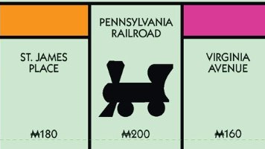
Week 2 Progress

Slide 2
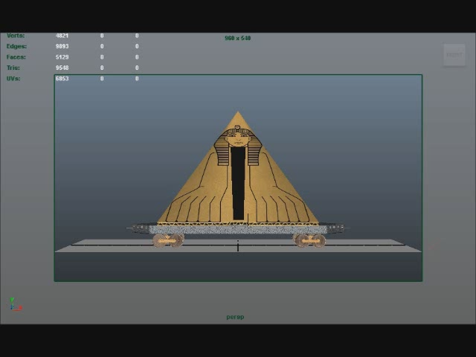
Art Development - Progress

Slide 3
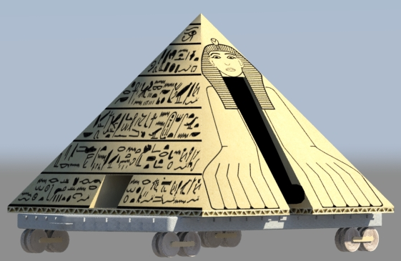
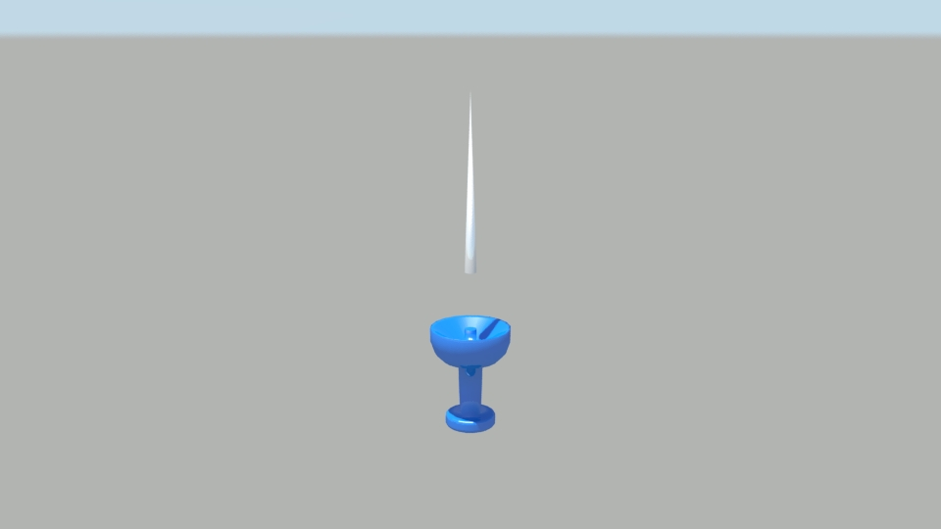
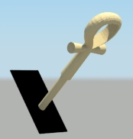
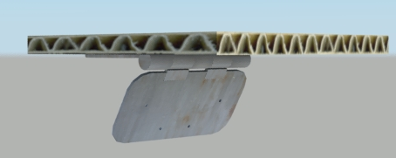
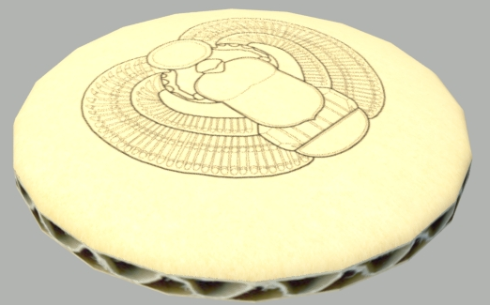
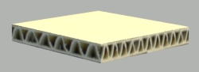
Art Development - Progress
Modelled ancient carriage → 75% textured
Modelled & Textured assets

Slide 4
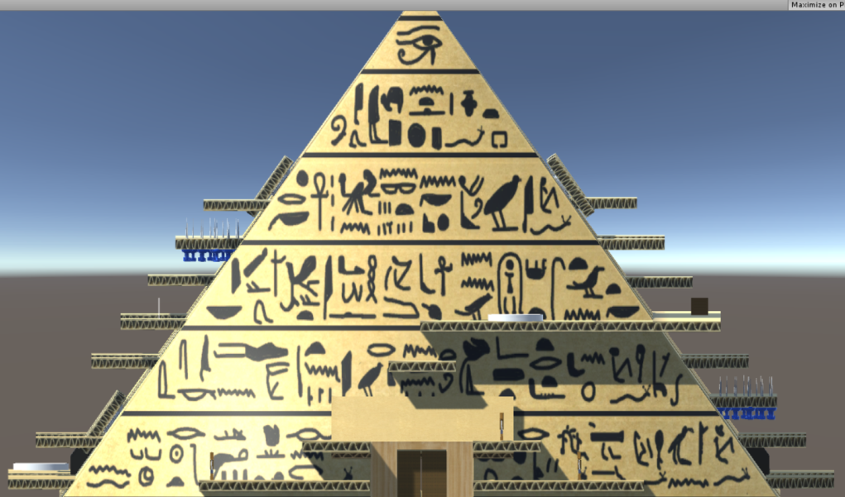
Level Design Progress
Tutorial Level placeholder assets with some working script implementation
The Ancients Level placeholder assets with some script implementation
Adventurer Level almost complete!
Some bug fixing
Minor textures
External testing feedback

Slide 5
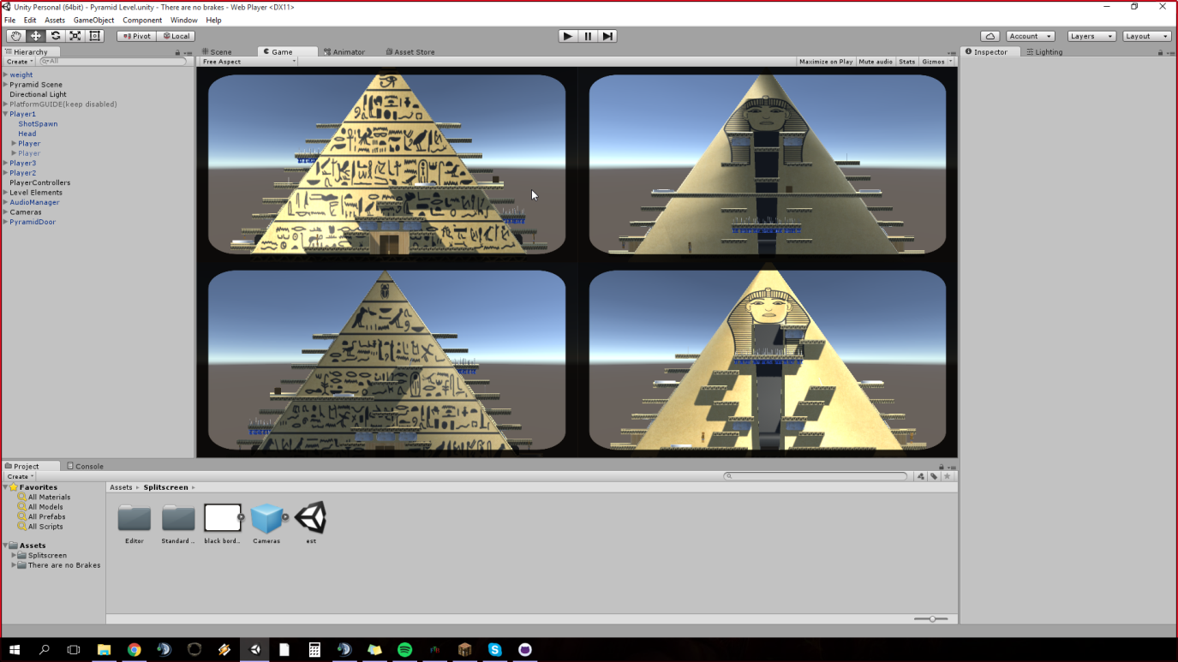
Script Implementation
New camera system nearing completion (displays multiple areas of the level simultaneously)
Faction specific mechanics implemented for Adventurer/The Ancients carriage

Slide 6

Administration Setup
Weekly Progress Reports → Google Doc (saved locally and uploaded to GitHub at the end of each sprint)
Spreadsheets (preliminary)
Week 5 Goals
Weekly Development Plan
Backlog (to do)
Back Ups for all docs on GitHub repository

Slide 7
Plans for next week
Pyramid carriage fully implemented
Tutorial carriage fully implemented (may be pushed back depending on progress)
Prototype Industrialist Carriage
Full camera implementation
Internal Playtesting/Debugging

